Slide 1
Identifying musk and non musk

Slide 2
Data cleaning:
Most of the data are clean there is no missing value in any variable so In this I remove three variable ID, molecule name, conformation name.

Slide 3
Models:
In this project I used Logistic regression, Decision tree, Random forest, SVM model.
This model use because our dependent variable is binary.

Slide 4
Logistic Regression
This model only used for binary classification.
Logistic Regression with cross-validation:
A/P | 0 | 1
0 | 1087 | 28
1 | 34 | 171
0 – Non-Musk
1 – Musk
A/P = Actual vs Predicted
Train accuracy | test Accuracy | Sensitivity/Recall | Specificity | Precision | F1 Score
95.30% | 95.30% | 0.7822 | 0.9750 | 0.1266 | 0.1279

Slide 5
Decision Tree:
This model use for both regression and classification
A/P | 0 | 1
0 | 1091 | 24
1 | 24 | 181
test Accuracy | Sensitivity/Recall | Specificity | Precision | F1 Score
96.36% | 0.44059 | 0.99553 | 0.0740 | 0.1267

Slide 6
Random Forest:
This model use for both regression and classification.
A/P | 0 | 1
0 | 1107 | 8
1 | 27 | 178
test Accuracy | Sensitivity/Recall | Specificity | Precision | F1 Score
97.3% | 0.8812 | 0.9982 | 0.13755 | 0.2379

Slide 7
SVM Model:
This support vector machine model use for classification.
A/P | 0 | 1
0 | 1115 | 0
1 | 127 | 79
Train accuracy | test Accuracy | Sensitivity/Recall | Specificity | Precision | F1 Score
90.41% | 97.12% | 0.8564 | 1.000 | 0.1349 | 0.2330

Slide 8
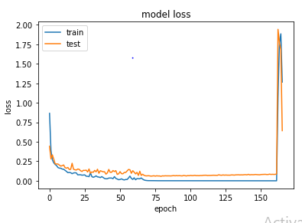
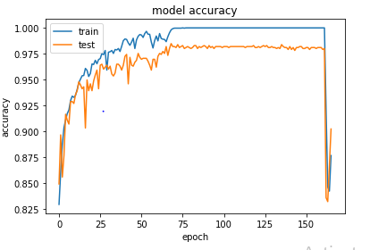
loss and accuracy curves:

Slide 9
Conclusion:
In this project I used logistic regression, decision Tress, Random Forest, SVM model and on the basis of facts, I can say that Random forest is the best model as this model is giving good result in comparison to other model.

